Slide 1
BSA TROOP 23
Finances
Parent Meeting 2023

Slide 2
BSA TROOP 23
Ritchie Bufkin
Troop 23 Treasurer
SarasotaTroop23Treasurer@gmail.com
941-465-8952

Slide 3
Dues
BSA TROOP 23
Scout accounts will be charged:
19 Aug, 2024
1 Feb, 2025
New to troop also owe $75 one-time equipment charge
Council Fees:
New BSA charge, $25 for first time scouter
$85 Youth
$65 Adult
$110
scouts
$0 adults

Slide 4
Ways to Pay
BSA TROOP 23
Check
Cash
Pay to the
order of
Pay to: TROOP 23
via the troop website
*% fees vary – payer is responsible

Slide 5
Fundraiser
BSA TROOP 23
Trails End Popcorn.
Use the App. More info coming from the “Popcorn Kernel”
Look for other fundraising opportunities throughout the scouting year.

Slide 6
General Activity Costs
BSA TROOP 23
Canoeing
Shooting
Backpacking
Competition
~$15 - $70 per activity

Slide 7
High Adventures
BSA TROOP 23
Sea Base
May - June 2025
Washington DC
June 2024
Leaders are putting together the plan and the budget and details will come out later in the year.

Slide 8
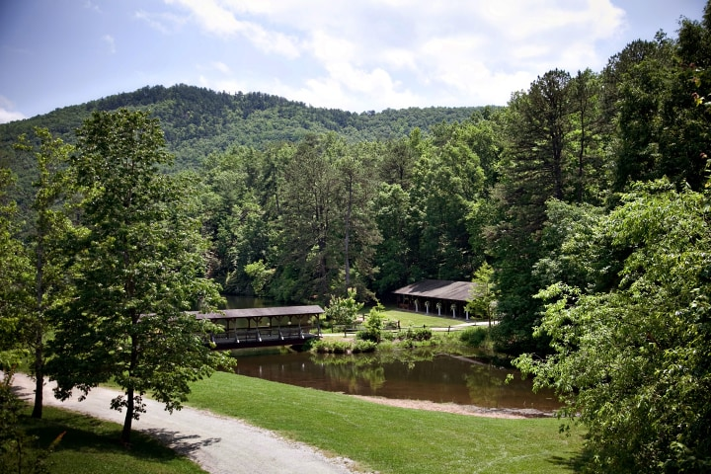
Summer Camp 2025
BSA TROOP 23
Camp Raven Knob
June 27 – July 5, 2025
Leaders are putting together the plan and the budget and details will come out later in the year.

Slide 9
Scout Accounts
BSA TROOP 23
You may already have funds on-hand to cover a portion of dues and activities
If your balance is negative, you owe that amount to the troop
Check your scout accounts on a regular basis and please pay any balances in-full asap.
Sent weekly

Slide 10
BSA TROOP 23
All Transactions Online
Your balance

Slide 11
When to Make Deposits
BSA TROOP 23
Your scout tells you he’s signing up for an activity
You see a negative balance at the top of your Weekly Sunday Email Newsletter
You get an email from me that you have funds due.

Slide 12
When to Make Deposits
BSA TROOP 23
Weekly Sunday Email Newsletter
Your balance

Slide 13
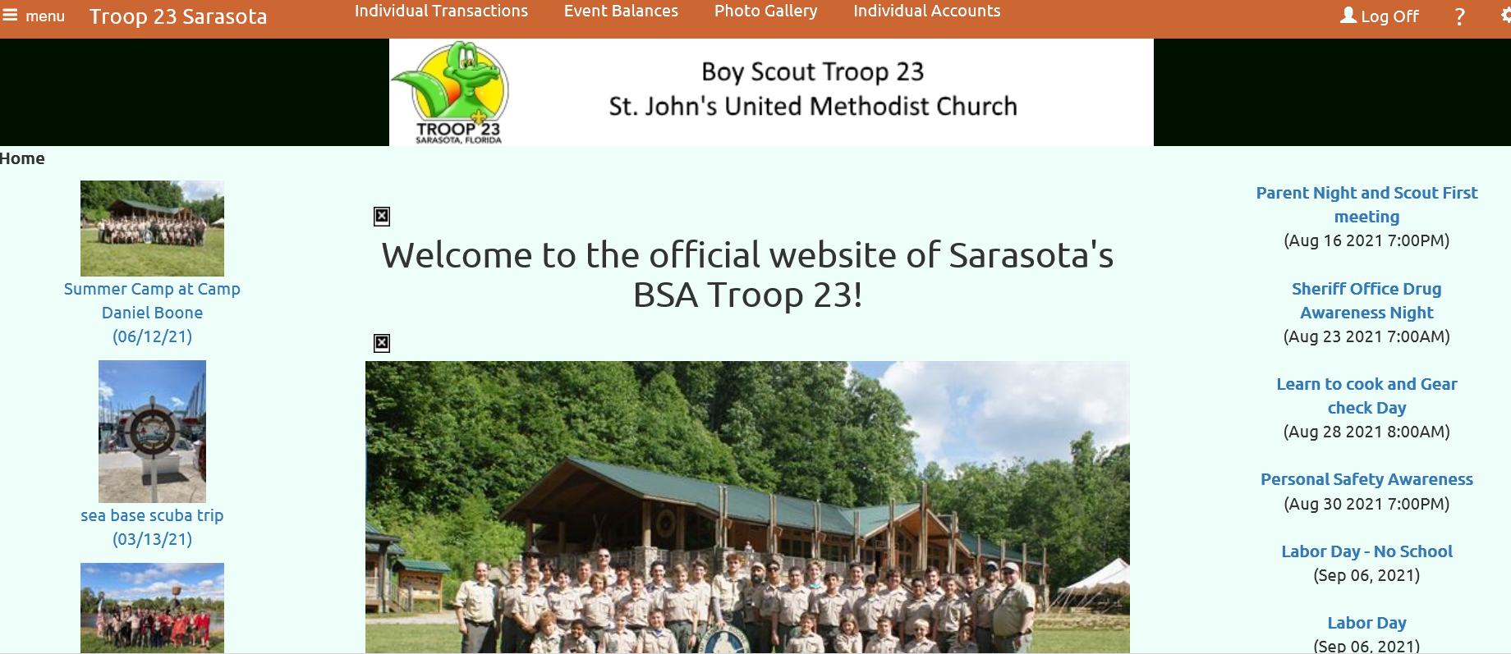
Troop Web Host
BSA TROOP 23
Check the website often!
Sign-up for activities early
Pay balances BEFORE leaving for activity
We are here to help!
Reach out for one-on-one web site instruction.

Slide 14
BSA TROOP 23
Questions and Help
John Bartolome
SarasotaTroop23Treasurer@gmail.com
941-306-9580

