Slide 1
2024-2025
PARENT INFORMATION MEETING
August 19, 2024

Slide 2
The Mission
The mission of the BSA is to prepare young people to make ethical and moral choices over their lifetimes by instilling in them the values of the Scout Oath and Scout Law
Using well-defined and established Aims and Methods, the Scouts BSA program develops future leaders.

Slide 3
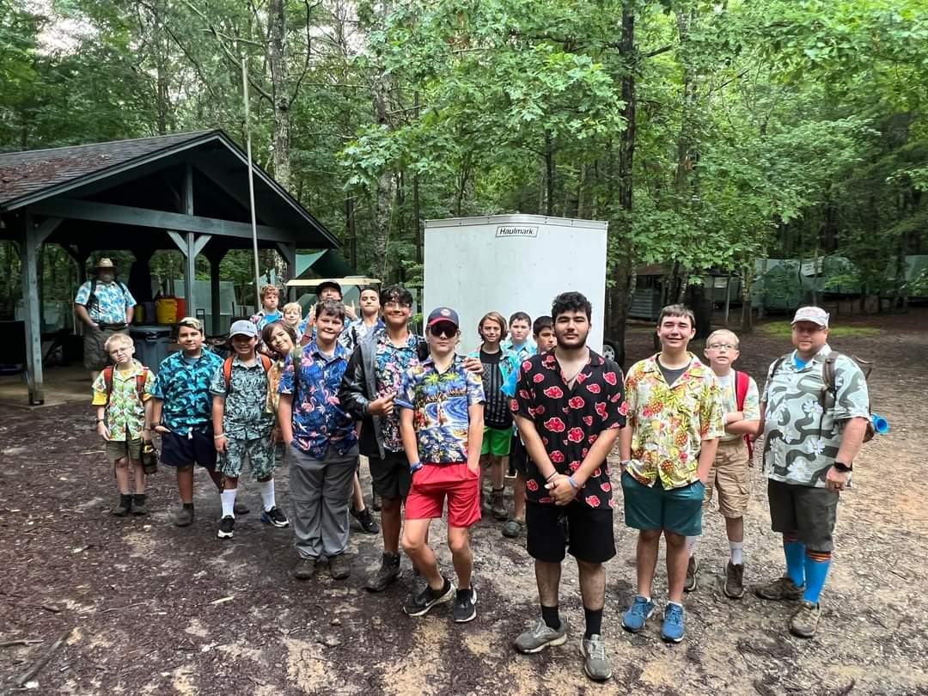
The Aims
All levels of Scouting Share 4 specific Aims
Character Development
Citizenship Training
Physical and Mental Fitness
Leadership Development

Slide 4
The Methods
Use 8 Methods to provide fun and adventure to achieve Scouting’s Aims
Ideals – Scout Oath, Law, motto, slogan
Patrol Method – Leadership, 5-8 scouts
Outdoor Program
Advancement – Rank , Merit badges
Adult Association – role models
Personal Growth
Leadership
Uniform – comradery, sense of belonging, public recognition – Pride in the Troop

Slide 5
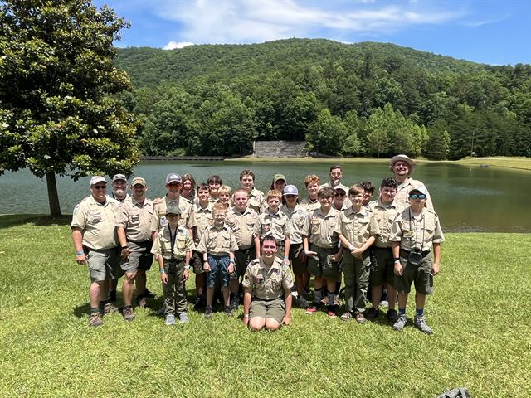
CAMP RAINEY MOUNTAIN 2024

Slide 6
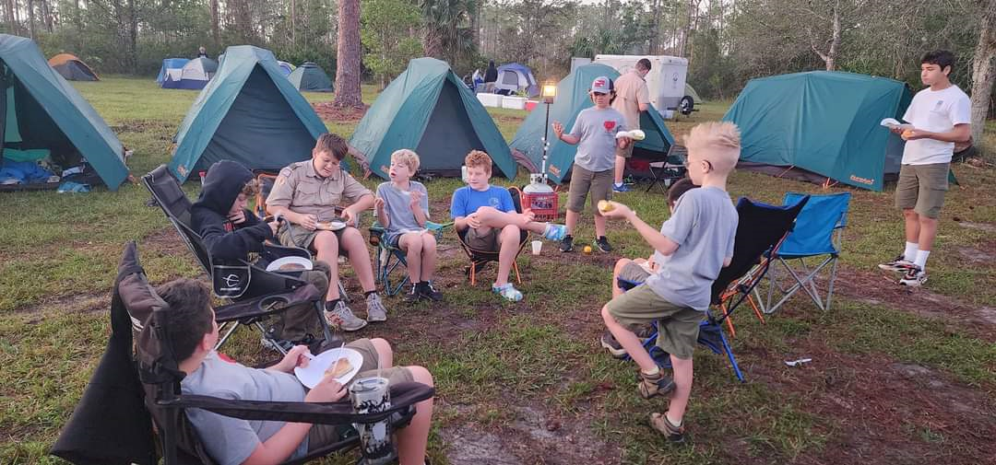
The Scouts
35 registered Scouts
Goals
Advance 16 Younger Scouts to First Class
More participation
Engage with New Life Lutheran Church
11 Life Scouts = Community Service
Eagle scouts
The Class A uniform

Slide 7
Calendar Highlights
PATROL LEADERS’ COUNCIL
Aug 24: Bowling @ Bowlero 2-4pm
Sep 20-22: Kelly Rock Springs Campout
Oct 4-6: Cowen Challenge
Oct 7: Court of Honor
Oct 28: Halloween Party
Nov 8-10: Fort Desoto Campout
Dec 6-8: Brokeback Dog (Camp Miles)
Dec 16: Scout Holiday Party
Jan 17-20: St. Augustine / NASA trip
Summer Camp – Raven Knob – June 27-July 5
High Adventure: May 31-Jun 7 - Sea Base –Out Island
Washington DC Trip – June 15-21

Slide 8
Paperwork/Forms/ $ Dues $
Forms needed for each Scout
Hold Harmless Agreement
Medical Information (and Insurance Card)
OTC Drug Permission
Contact Information
Conduct and Behavior Policy
BSA Health & Medical A/B
Dues payment ($110 scouts/$0 adult leaders)
Fall – 19 Aug, 2024 ($55)
Spring – 1 Feb, 2025 ($55)
One-Time New Scout Equipment Fee ($75)

Slide 9
Where do your dues go?
Recharter Fee
Troop equipment repair and replacement
3 trailers: registration and replacement
Patches and Awards
Administrative expenses
Troop contribution to leadership training and parties

Slide 10
Troop Website: www.troopwebhost.org
IDs and passwords emailed to all parents and scouts -Encourage scouts to use website
Calendar
On-line sign up for activities
On-line payments
Forms
Email/Text communication: Please add SMS text mail address to personal information

