Slide 1
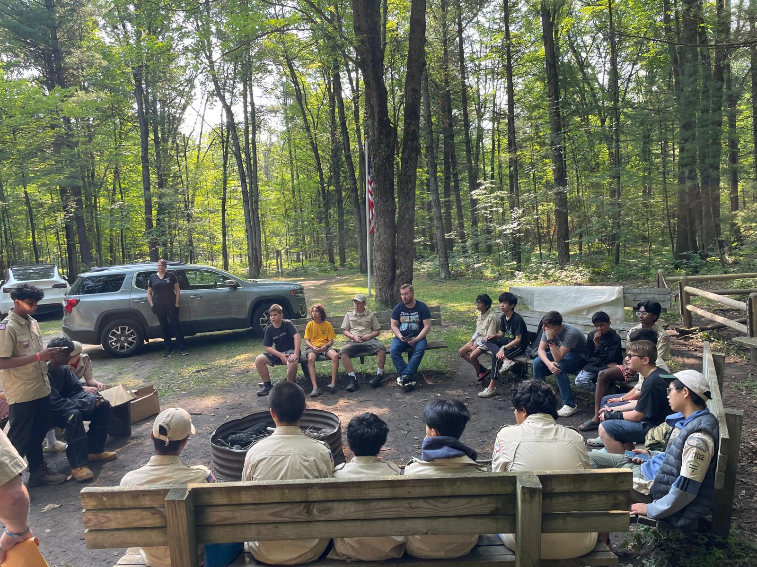
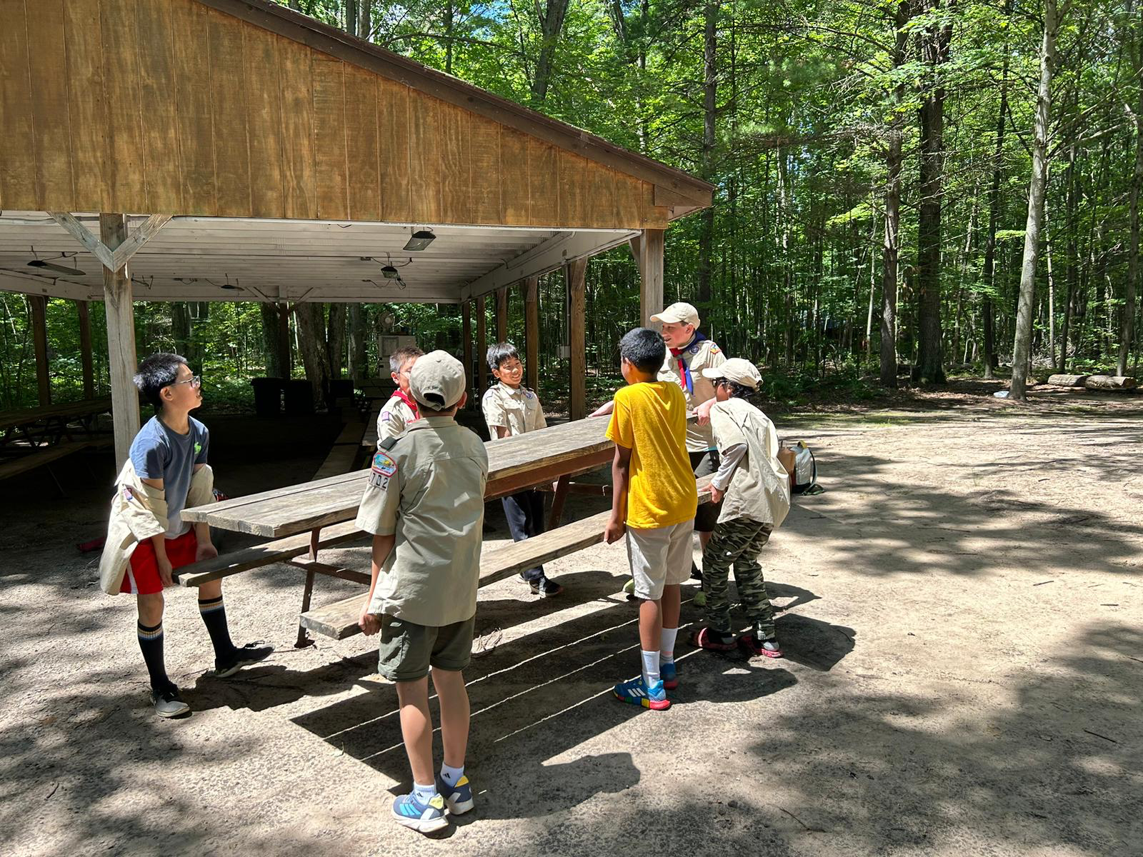
Welcome To Troop 1702 Summer Camp Parent Meeting
For Summer 2025
Updated January 29, 2025

Slide 2
Introductions

Slide 3
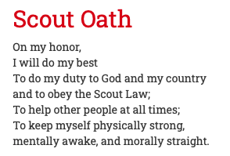
Scouting Builds Character

Slide 4
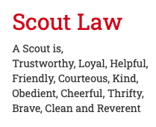
Scouting Builds Character

Slide 5
Camp Video

Slide 6
Why Cole Canoe Base
Troop 1702 has attended for many, many years
Only two hours away
Great program, staff, logistics
Troops cook their own meals
Adopted a prime campsite called Deer Run
Continue to support adopted site through annual donation, upgrades and upkeep

Slide 7
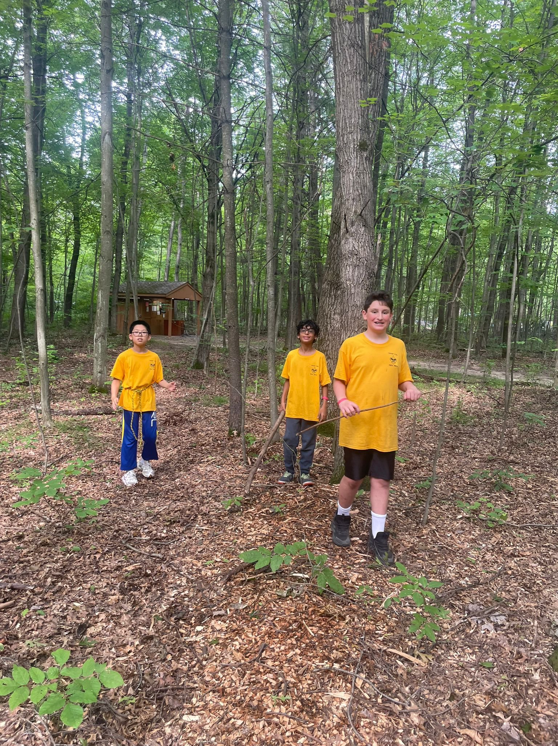
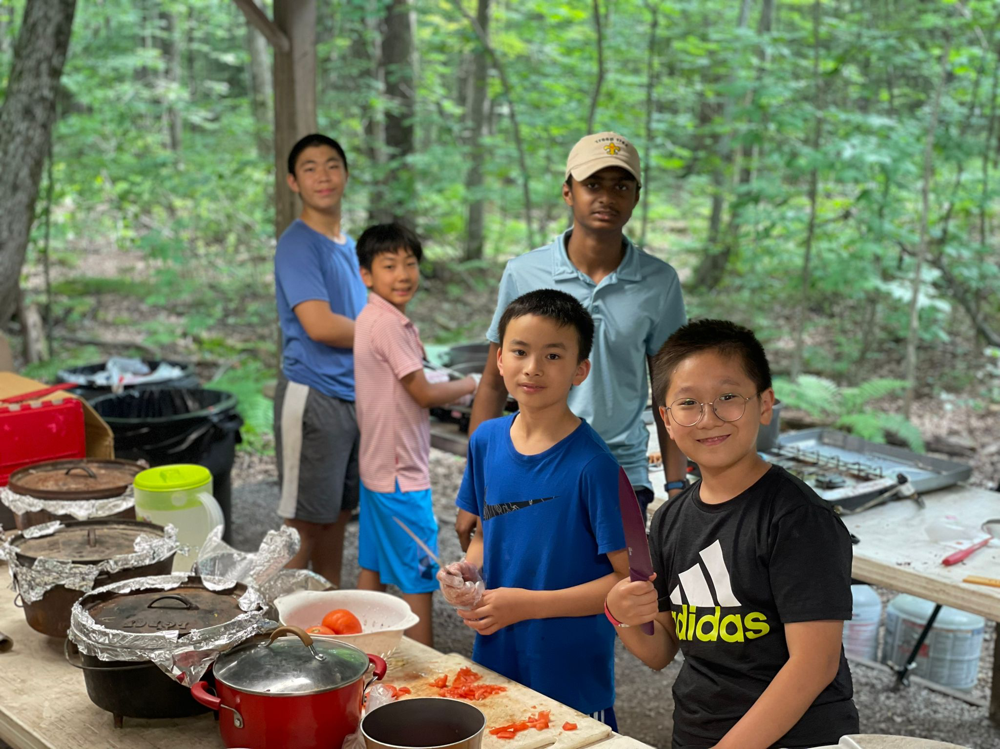
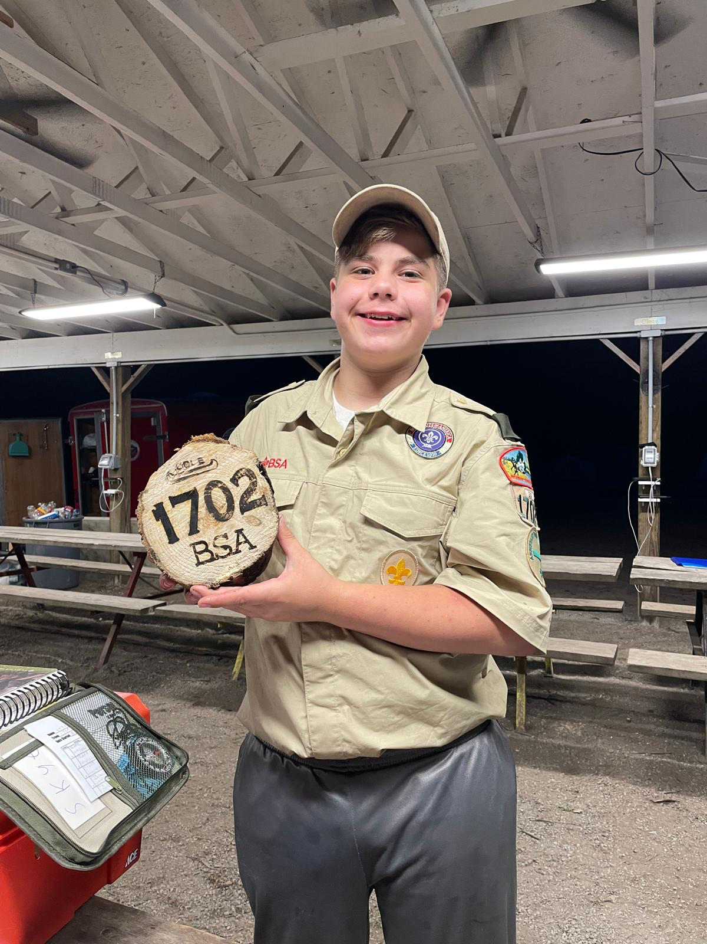
Deer Run Campsite

Slide 8
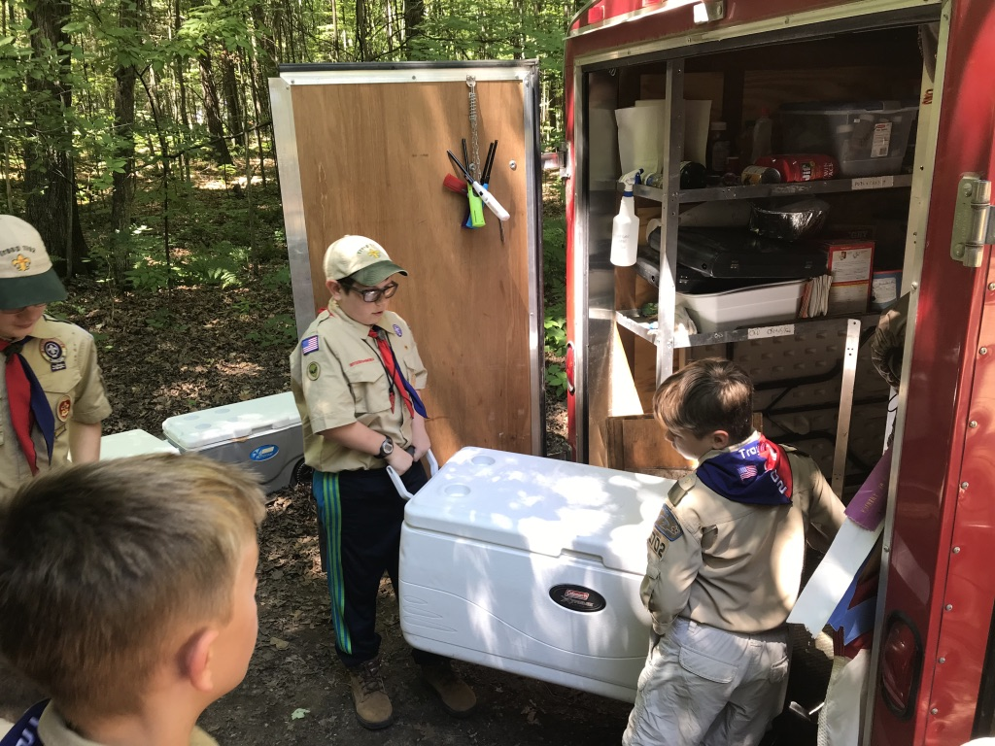
When
Sunday, July 6th to Saturday, July 12th 2025
6 nights
Depart from Bemis Elementary Sunday 9am
Stop for Lunch (Subway) before arriving to camp
End of camp - Saturday 9am, pack up, arrive home in Troy around noon

Slide 9
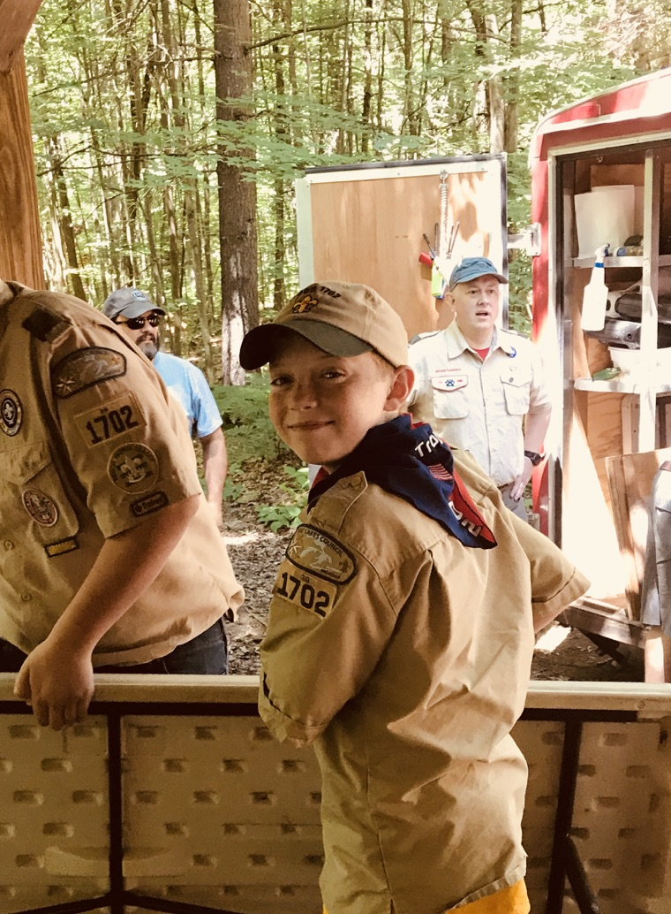
Cost
Early bird discount and new Scouts ~ $399
After May 1 cost increases to $449
$120 First payment due Feb 28th
Sibling discount $35 on second child
Need based scholarships available through BSA
Includes all food and activities
Exception for a few things like ATV riding
Troop provides all cooking equipment, propane, tents, merit badges, and other supplies for the week

Slide 10
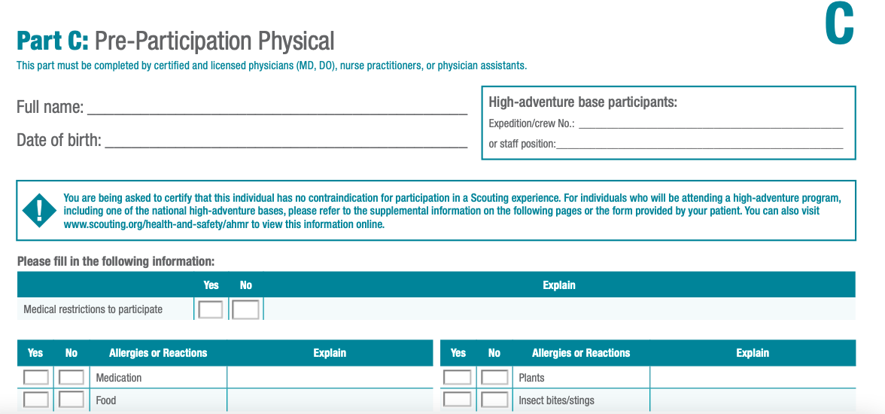
Required Camp Forms
BSA Medical Form Part A/B/C – Required for all scouts and adults attending camp
Adult DHS Registry – required for any adult visiting or attending camp

Slide 11
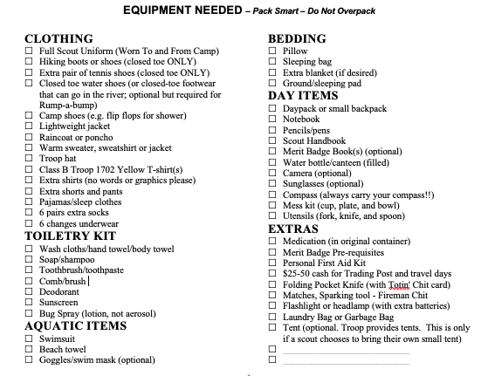
Packing List
Details will be on Permission Slip in May

Slide 12
Special Diet/Allergies/Medication
Need to know ahead of time
We update camp registration for special diets and food allergies
Make sure your scout speaks up for himself if food is not in line with special diet
Medication
Can only be dispensed by a troop adult. Turn in Troop medication form and medication on departure day.
If your scout has serious medication requirements or behavior challenges, we encourage you to attend as a troop adult volunteer

Slide 13
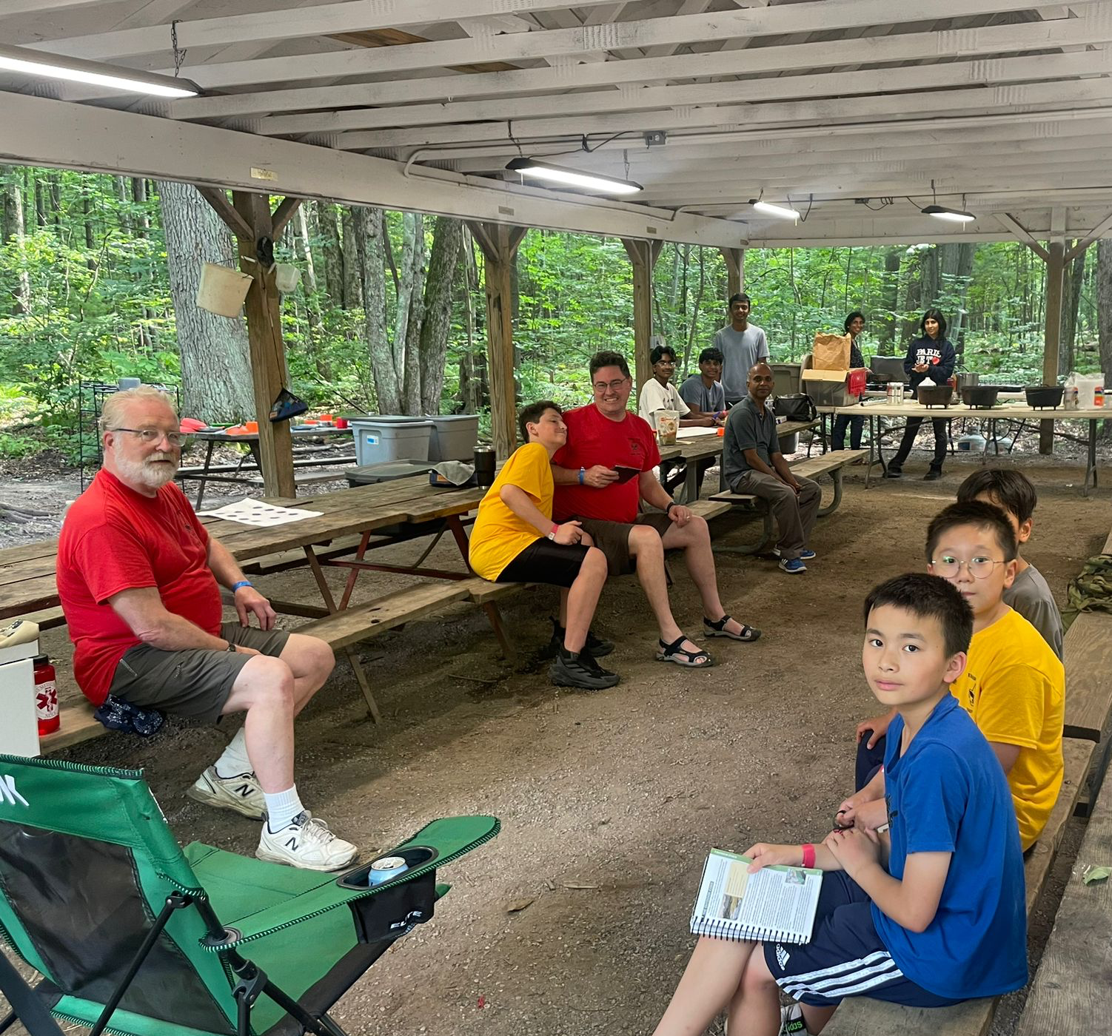
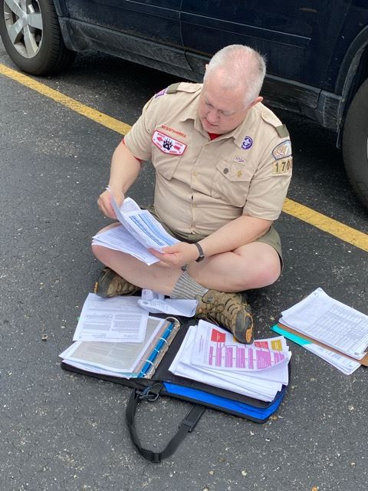
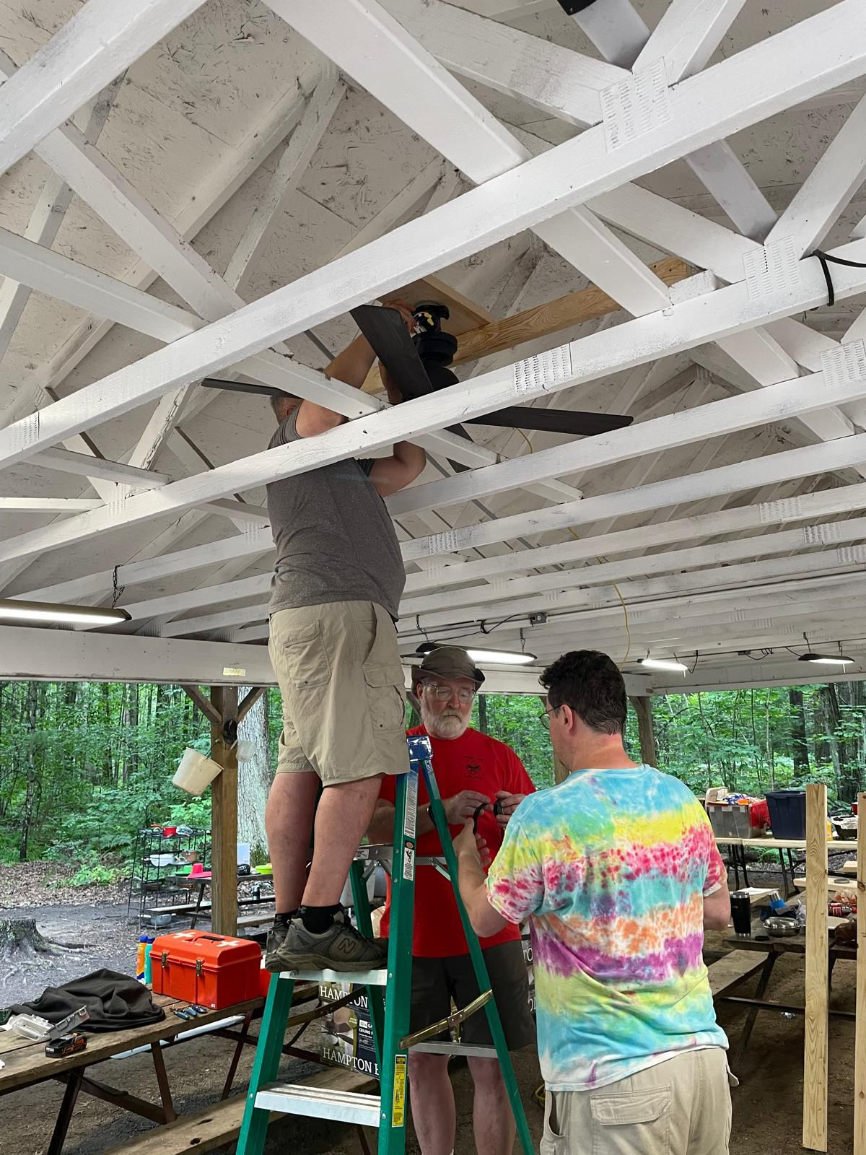
Supervision
Every troop provides their own troop supervision
We send 4 adults from our Troop to camp
Ideal to have 4 adults that attend the whole week
Ideal to have one parent familiar with dispensing medicine
Role is safety and security; outdoor skills nice but not required; sometimes help with special activities like ice cream social, beast feast or first year program
Training opportunities available to adults while at camp

Slide 14
Electronics
None allowed
Exception for phones if needed as a camera for specific activity
Highly discouraged
Battery won’t last
Scoutmaster will store it for you
Troop adults will take it away if being used during camp

Slide 15
Pre Camp Swim Checks
Prior to camp, will do local swim check to have each scout classified for swim status
Can do the swim check first day at camp if necessary

Slide 16
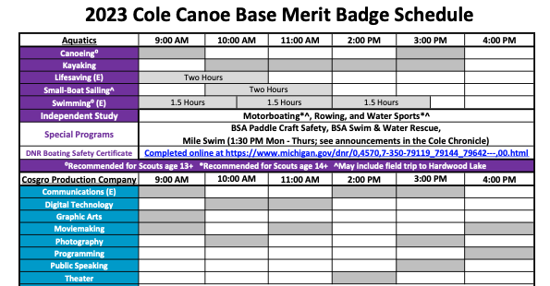
Camp Class Schedule Example

Slide 17
Prerequisites
Some merit badges have pre-work
If they don’t complete it, they get a partial and will need to complete it later and find a counselor to get it fully signed off

Slide 18
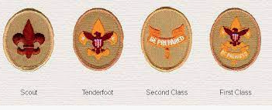
First Year Campers
Camp provides a first year program
1st year scouts work on rank requirements towards first four ranks
1-2 Merit Badge Classes Recommended:
First Aid – an Eagle Required Merit Badge
And another fun badge like chess, leatherworking
Earn Firem’n chit and Totin’ chip

Slide 19
Next Steps
How to register?
Troop will register scout once payment is received
Sooner you register, better the class options
Health forms
Make dr’s appointment if necessary
Complete and make electronic copy, keep a copy, turn in a copy
DHS registry (if you might be visiting camp) –
Send in form by May 1 to ensure timely return
Confirm special diet needs by last troop meeting

Slide 20
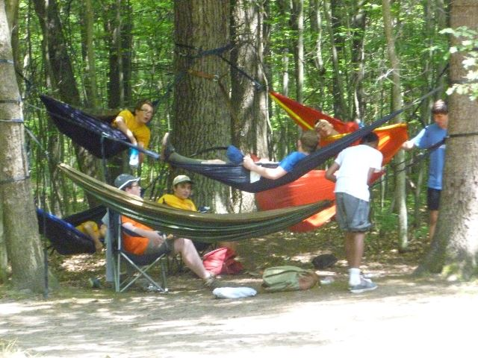
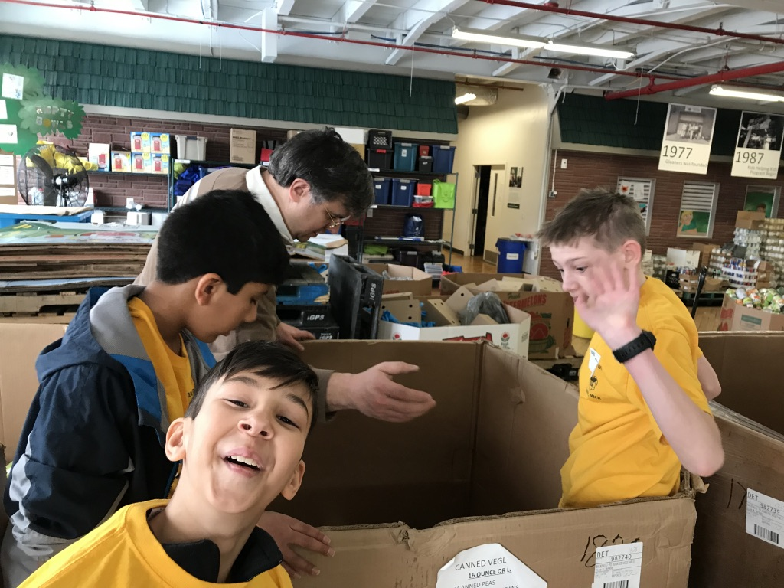
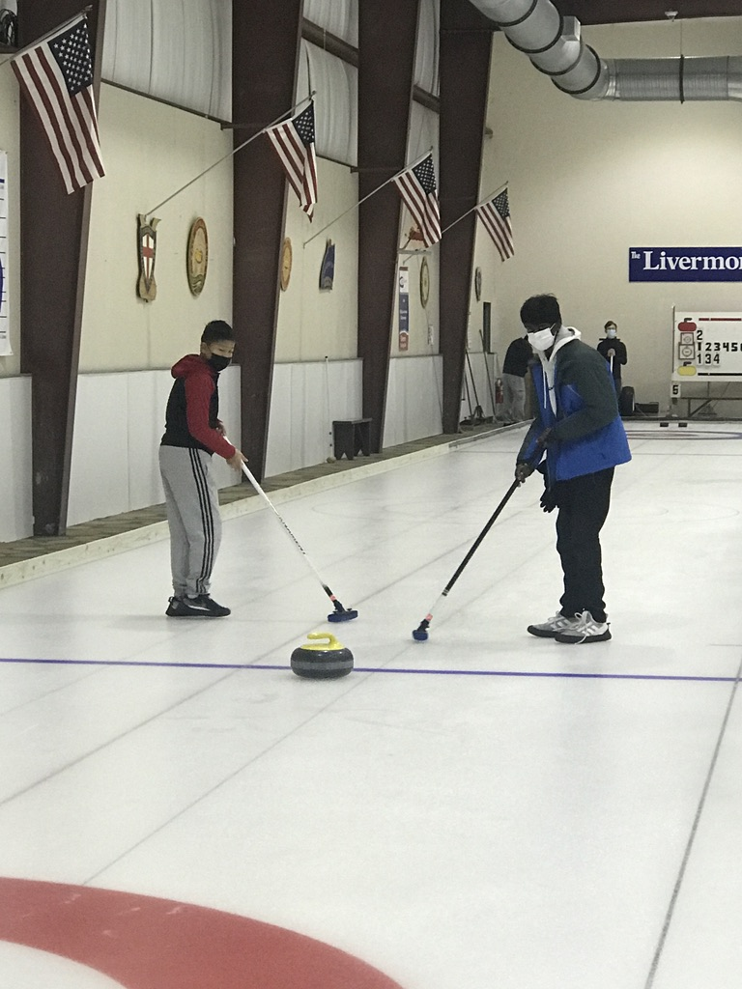
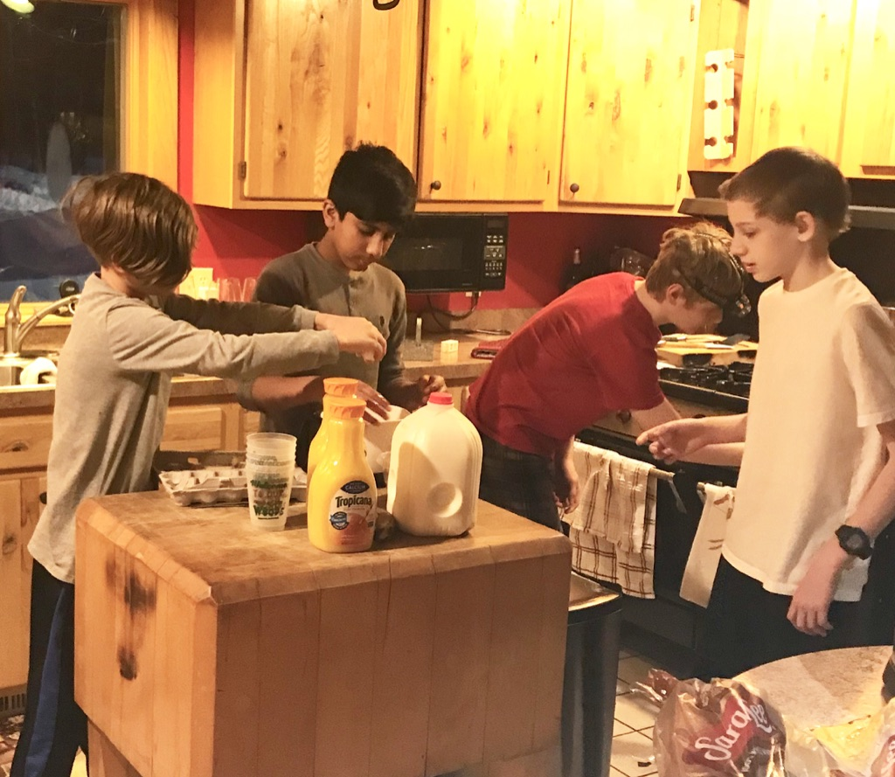
Scouting Is Fun!
Troop 1702
Troy, Michigan

